Slide 1
ANALYSIS AND DASHBOARD OF CRYPTO CURRENCY USING POWER BI
MIRZA AHSAN BAIG
DS-074/2020-2021

Slide 2
TOOLS AND LIBRARIES USED
Python (libraries are request , pandas, string and var)
Api of “Crypto compare” for live data
Postgresql (“For Dumping Data”)
Power BI for dashboard

Slide 3





Pipeline:

Slide 4
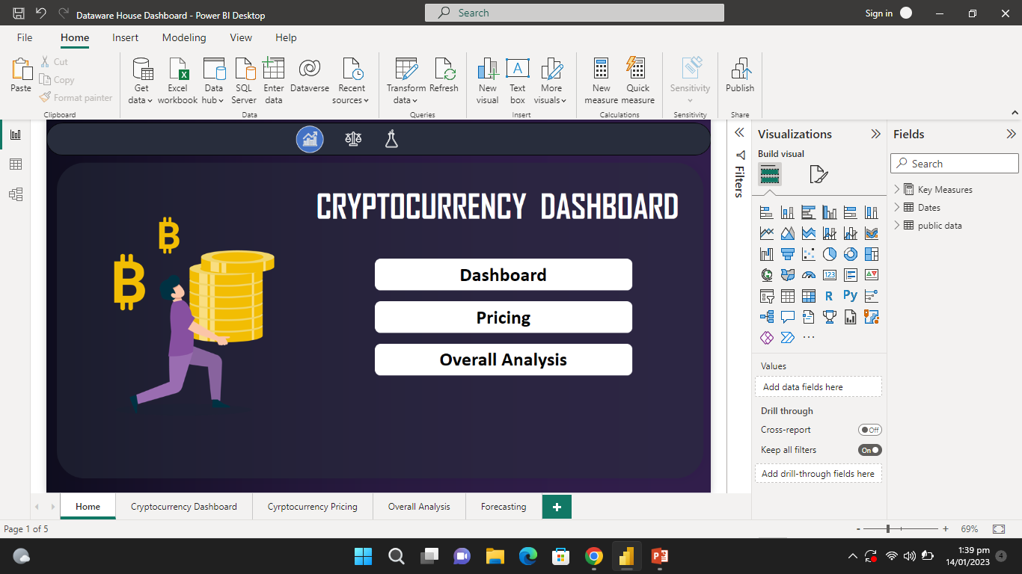

Slide 5
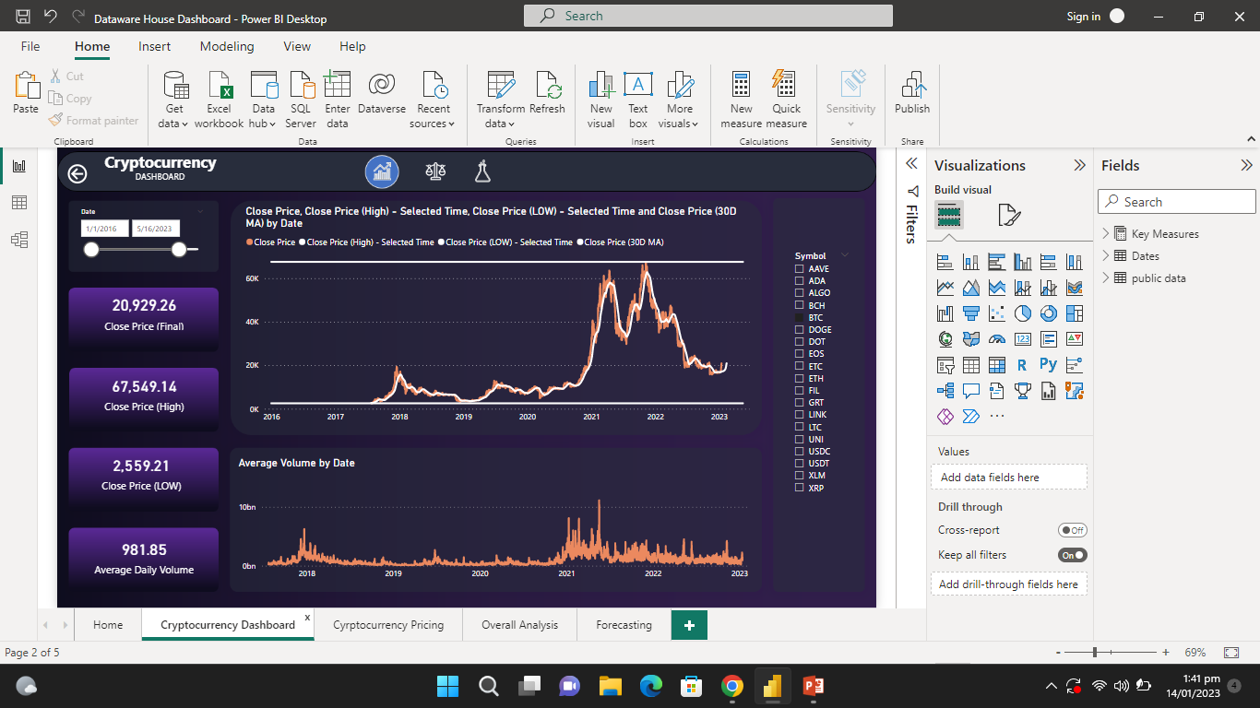

Slide 6
